Slide 1
NAF Internal Controls
School for Family and MWR
Module 1:
Internal Controls
in the
Operational
Environment

Slide 2
Introductions
Your Name
What do you do for Family and MWR?
How many years have you worked for Family and MWR?
What is your favorite Family and MWR memory?

Slide 3
Policies and Procedures
Attendance:
Class time is 0900-1800
You must attend all modules and may miss no more than 5% of class time to earn credit
Failure to meet this requirement will result in an incomplete
Breaks
Lunch – 1 hour
Breaks – 1 in the AM and 1 in the PM
Classroom Expectations
Be on time to class and returning from breaks.
Actively participate in group discussions and exercises.
Complete all assignments.
Respect your fellow participants.
Place cell phones on silent or vibrate.

Slide 4
Foundation Courses & Pre-work
Foundation Courses
Family & MWR Orientation (online)
Operation Excellence (online or classroom)
Family & MWR Basic Management Course (online)
Pre-work
Review Module 9 of the Family and MWR Basic Management Course: Management Controls
Review United States Government Accountability Office (GAO) AIMD-00-21.3.1 - Standards for Internal Control in the Federal Government – The GREEN BOOK
Interview a Manager in your chain or FM expert on RMIC and return pre-class.

Slide 5
Admin Items
Assignments
Provided during class and as homework between sessions
Participant Guide
Grading
75% or better required to pass
ACE and IACET CEU Recommendations
ACE: One (1) semester hour in Risk Management in the lower division baccalaureate degree category
IACET CEU: 0.7 (must attend whole session, complete all exercises, submit end-of-course survey and obtain a 75% or better)
References and forms:
https://www.imcomacademy.com/ima/?page_id=11999
5. The Risk Assessment for taking this course is determined to be LOW
Pursuant to AR 27-60, Intellectual Property, dated 17 Jun 2015 and SFMWR SOP_ANSI/IACET CEUs (dated 31 Oct 2023) states that no faculty or instructor has proprietary interest in any products, instruments, devices, or materials related to this course.

Slide 6
Course
Expectations

Slide 7
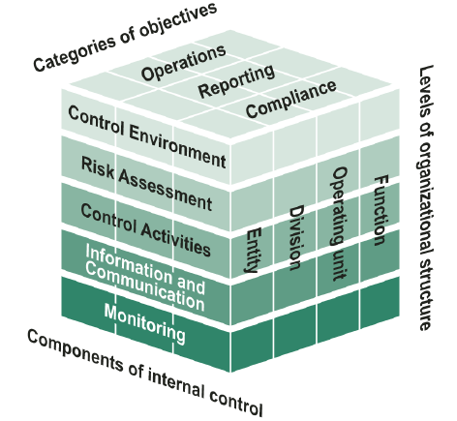
Course Objective
Given the Government Accountability Office (GAO) framework for Internal Controls, learners should be able to analyze the five standards and apply the standards to daily operations to ensure reasonable control over their area of responsibility.

Slide 8
Five Standards of Internal Controls
Information & Communication
Control Environment
Risk Assessment
Control Activities
Monitoring

Slide 9
Five Standards of Internal Controls
Information & Communication
Information should be recorded and communicated to management and others within the entity who need it; and in a form and within a time frame that enables them to carry out their internal control and other responsibilities.

Slide 10
Five Standards of Internal Controls
Information & Communication
Control Environment
Risk Assessment
Control Activities
Monitoring

Slide 11
Five Standards of Internal Controls
Control Environment
Management and employees should establish and maintain an environment throughout the organization that sets a positive and supportive attitude toward internal control and conscientious management.

Slide 12
Five Standards of Internal Controls
Information & Communication
Control Environment
Risk Assessment
Control Activities
Monitoring

Slide 13
Five Standards of Internal Controls
Risk Assessment
Internal control should provide for an assessment of the risks the agency faces from both external and internal sources

Slide 14
Five Standards of Internal Controls
Information & Communication
Control Environment
Risk Assessment
Control Activities
Monitoring

Slide 15
Five Standards of Internal Controls
Control Activities
Internal control activities help ensure that management’s directives are exercised. The control activities should be effective and efficient in accomplishing the agency’s control objectives.
For example, a lock on a door, or the processes we have in place at the end of the day.

Slide 16
Five Standards of Internal Controls
Information & Communication
Control Environment
Risk Assessment
Control Activities
Monitoring

Slide 17
Five Standards of Internal Controls
Monitoring
Internal control monitoring should assess the quality of performance over time and ensure that the findings of audits and other reviews are promptly resolved.

Slide 18
Five Standards of Internal Controls
Information & Communication
Control Environment
Risk Assessment
Control Activities
Monitoring

Slide 19
Internal Controls Brainstorm
In your small groups, please identify the 2 most important reasons why we have internal controls.
List these reasons on your chart paper.
Choose someone to out-brief the large group.
You will have five minutes to complete this.

Slide 20
Module 1 Objectives
Explore the roles and responsibilities associated with Internal Controls and established monitoring plan.
Identify breakdowns in internal controls, impacts and possible mitigating responses.
Relate each standard of internal controls to the operational environment.
Given the 5 step Risk Assessment process, determine level of risk.

Slide 21
Five Standards of Internal Controls
Information & Communication
Control Environment
Risk Assessment
Control Activities
Monitoring

Slide 22
Roles & Responsibilities
Senior Responsible Official (SRO)
The SRO is the Director of the Directorate that the Internal Control function falls under.
Assessable Unit Managers (AUM)
The AUM is the military or civilian head of an assessable unit.
Internal Control Administrator (ICA)
The ICA is the individual designated by the SRO to administer the MICP for a reporting organization.
Internal Control Evaluator (IC-E)
The IC-E tests controls, gathers supporting documents and ensures the Internal Control Evaluation Plan (ICEP) is followed.

Slide 23
Roles & Responsibilities
POSITION
ROLE
HQ IMCOM
ID Director
Senior Commander
Garrison Commander
DFMWR
Division Chief
Program Manager
SRO
AUM
ICA

Slide 24
Roles & Responsibilities
Where does the Risk Management Internal Control (RMIC)* fit in with my roles/responsibilities as a Family and MWR Program Manager?
Follow guidance provided by your local ICA
Complete training for your level within the RMIC
AUM (usually Director and Garrison Commander),
ICA/Alt ICA (appointed by Director/GC),
Evaluators (usually division chiefs), and
Managers
What else?
*Formerly the Managers Internal Controls Program (MICP)

Slide 25
Conducting An Analysis

Slide 26
Group Instructions
Take a few minutes to read the scenario of Bob the Bowling Manager.
Using the scenario, answer the questions:
What is your impression of the Bowling Center program in this scenario?
Is there anything you would change within the Bowling Center program?
Who should Bob have contacted?
Identify possible areas for fraud, waste, and abuse.
Choose someone to scribe on the chart paper.
Choose someone to outbrief to the large group.
You have 10 minutes to complete this exercise.

Slide 27
What Are Internal Controls?
A process affected by an organization’s people, designed to provide Reasonable Assurance in reliability of financial reporting, compliance with laws and regulations, and effective and efficient operations.
A control is any technique, tool, device, check or balance in our everyday work - Designed to ensure what should happen does happen; what shouldn’t happen, doesn’t happen.
We have controls throughout our daily lives. We just don’t think about them. Sometimes we institute them from hard lessons learned.

Slide 28
Why Are Internal Controls Important?
Internal Controls are part of effective management.
Internal Controls ensure:
- Accurate and Reliable Information
- Compliance with Laws & Policies
- Safeguarding of Resources
- Economical & Efficient Use of Resources
- Safety of Operations

Slide 29
Internal Control Objectives
Reliability of financial reporting
- Accountability
Compliance with Laws and Regulations
- Compliance
Effectiveness/Efficiency
of Operations
- Effective/Efficient

Slide 30
Reasonable Assurance
An acceptable degree of confidence in the general reliability of internal controls to deter or detect material failures in complying with the Federal Manager’s Financial Integrity Act (FMFIA) objectives.
The determination of reasonable assurance is a subjective management judgment based on “confidence that internal controls are adequate and operating as intended.”
Strive for “reasonable” assurance, not absolute assurance.
Adjust over time from lessons learned and in response to a changing environment.
Recognizes acceptable levels of risk exists that cannot be avoided because the cost of absolute control exceeds the benefits derived.

Slide 31
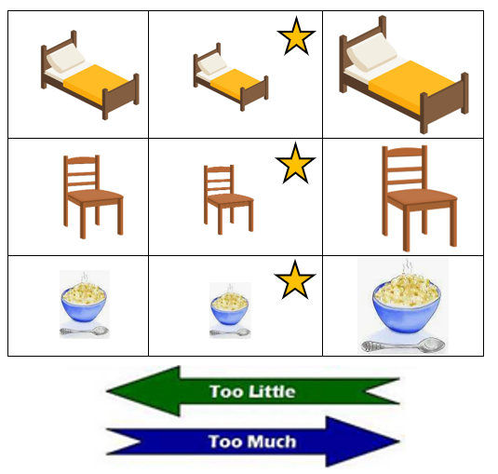
Reasonable Assurance
The “Goldilocks” Principle
OVERKILL: Armed escort for all employees during movement through IMCOM installations.
REASONABLE ACTION: Fulltime guard at entrances; screening IDs and visitor badges.
INSUFFICIENT ACTION: No guards at entrances; no screening process.

Slide 32
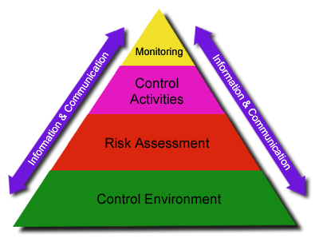
Control Environment
What do I do to ensure a “controlled environment” is in place?

Slide 33
Risk Management
WHAT IS IT? Risk Management is the process of evaluating the risks in a functional area based on the key internal controls that are in place.
- Risk assessment measures two quantities of risk:
1. Magnitude of the potential loss
2. Probability that the loss will occur.
The key internal controls employed to reduce risk should not exceed the benefits derived.
THE MYTH: Risk Assessment must ALWAYS be long and complex.
THE REALITY: On its own, paperwork never saved anyone. It is a means to an end, not an end in itself - Action is what protects people. Risk assessments should be fit for purpose and acted upon.

Slide 34
Risk Assessment
Identify Risks
- Identify Objectives
- Internal Factors
- External Factors
- Factors that increase the risk to the agency
Analyze
- Day to Day management of activities
- Potential for Loss
- Risk during change
Assess
- Rank using any qualitative or quantitative method
- Analysis of estimating risks impact
- Analysis of risk’s likelihood
Develop/Decide
- What controls should be in place to mitigate
the risk identified.
(1)
IDENTIFY
(5)
MONITOR
(2)
ANALYZE
ASSESS
(4)
IMPLEMENT
(3)
DEVELOP
DECIDE

Slide 35
Risk Assessment
Risk Assessment Matrix
 |  | Probability
Severity |  | Frequent A | Likely B | Occasional C | Seldom D | Unlikely E
Catastrophic | I | E | E | H | H | M
Critical | II | E | H | H | M | L
Marginal | III | H | M | M | L | L
Negligible | IV | M | L | L | L | L
E – Extremely High Risk H – High Risk M – Moderate Risk L – Low Risk

Slide 36
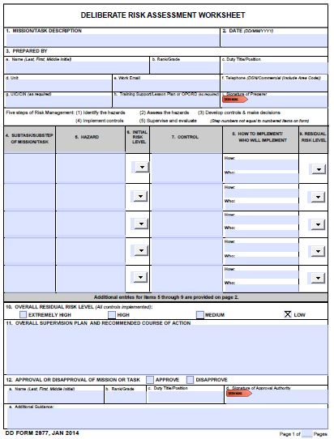
Risk Assessment
Questions to ask:
What is the task – what are you evaluating?
What is the hazard or potential hazard?
What CONTROL can you put in place to mitigate the risk?
Does the risk level change?

Slide 37
Assignment: DD Form 2977
Conduct a Risk Assessment of your cash management process (if you don’t have a cash management process, speak to your instructor for an alternative)
Complete the DD2977 Form individually
Brief your DD Form 2977 to your group
Provide feedback to each individual in your group
Receive feedback from your group members and update your form
Turn in your completed/updated form to your instructor

Slide 38
Module Objectives
Explore the roles and responsibilities associated with Internal Controls and established monitoring plan.
Identify breakdowns in internal controls, impacts and possible mitigating responses.
Relate each standard of internal controls to the operational environment.
Given the 5 step Risk Assessment process, determine level of risk.

Slide 39
NAF Internal Controls
Module 2:
Managing Internal Controls through “Reasonable Controls”
MG Robert M. Joyce School for Family and MWR

Slide 40
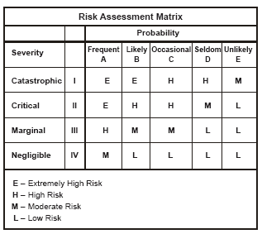
Module 1 Review
Risk Assessment
What did you learn about your program by using the Deliberate Risk Assessment?

Slide 41
Five Standards of Internal Controls
Information & Communication
Control Environment
Risk Assessment
Control Activities
Monitoring

Slide 42
Module 2 - Objectives
Identify and categorize the operational elements that require internal controls.
List drivers that determine need for an internal control.
Select the best type of control to meet program objectives.
Evaluate implementation of internal control to determine if they are being used as intended.
Evaluate controls to determine if they are effective in achieving objectives.

Slide 43
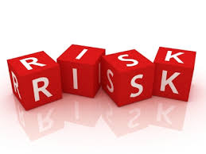
CATEGORIES
IDENTIFIED RISK FOR LOSS
CATEGORIES
MISSING MONEY
INVENTORY
UNSECURED BUILDING
EMPLOYEE ABSENCES
OUTDATED SOPs
PEOPLE
PROPERTY
FINANCIAL MANAGEMENT
PROGRAM COMPLIANCE

Slide 44
TRIGGERS & DRIVERS
IDENTIFIED RISK
IDENTIFIED TRIGGERS
CATEGORY
DRIVERS
Missing Money
Missing $157.00
Two people/One register
Building left unsecured
Financial Management
Program Compliance
Property
Laws
Regulations
Budget
2. Inventory
Improper inventory tracking
Beginning and End of Month inventory discrepancy
Inventory left unsecured
Program Compliance
Financial Management
Property
Laws
Regulations
Local Policies

Slide 45
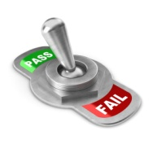
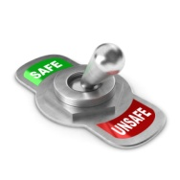
Control Activities
Reviews by Management at the Functional –or– Activity Level
Management of Human Capital
Information Processing
Segregation of Duties

Slide 46
Control
Activities
Provide an example of
a controlled activity.

Slide 47
Key Internal
Controls
Provide one example of a
“key internal control” you have
in place in your own program on
your Division’s Chart.

Slide 48
Selecting the Best Control(s) – Breakout Exercise Instructions
Each group will be assigned a process from the Bob the Bowling Manager scenario that requires an internal control.
Select a control for the process or procedure.
Answer the following questions
Why did you select this control?
What could be the consequences if you did not have the control in place?
Select a scribe to capture your responses on the chart paper.
Select Spokesperson to out-brief to the large group.
You have 10 minutes to complete the exercise.

Slide 49
Evaluation
of Control
Provide an example
of how to evaluate a control.

Slide 50
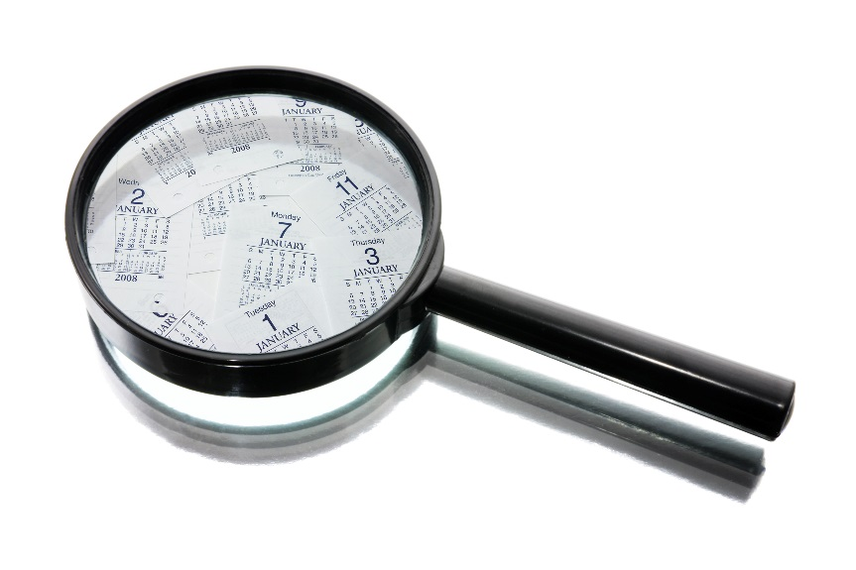
Internal Control Evaluation Plan (ICEP)
The ICEP documents required schedule of internal control evaluations.
The Internal Control Evaluation should identify the following:
Areas to be evaluated
Year for the evaluation
Official responsible for ensuring the evaluation is conducted

Slide 51
Internal Control Evaluation
The evaluation must indicate:
Who conducted the evaluation
The date the evaluation was conducted
The methods used to test key internal controls
What weaknesses were detected
A deficiency may be a material weakness
Corrective actions taken
What form exists to certify this evaluation process?

Slide 52
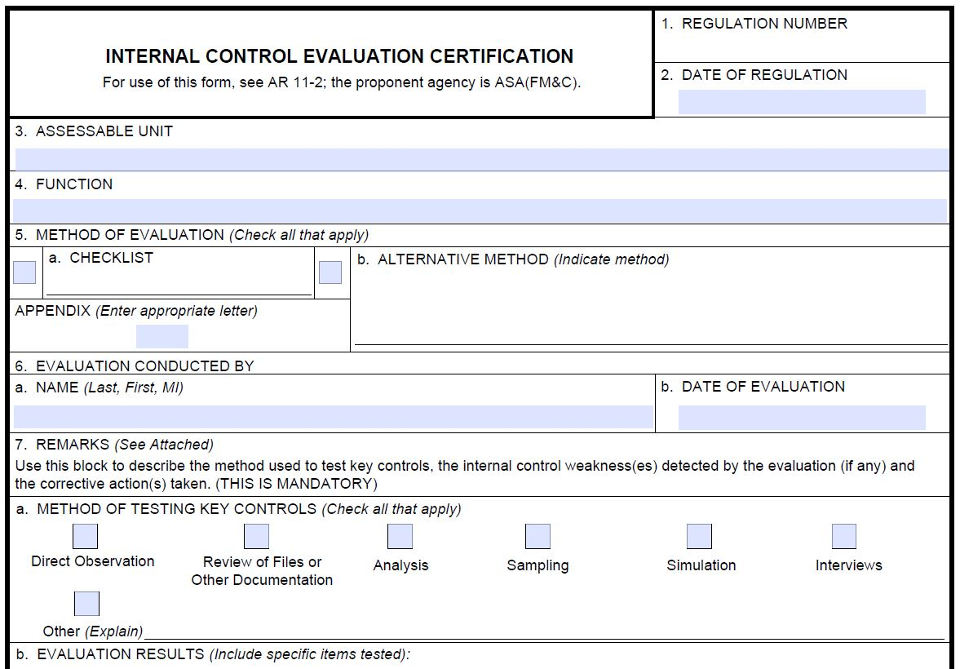
DA Form 11-2

Slide 53
How are our Internal Controls evaluated from the Headquarters/IDs or your Garrison Command?
DA Form 11-2 is submitted through the ID to the G8 at the Headquarters. Signed by your AUM.
Site Assistance Visits
Audits
Organizational Inspection Program (OIP) visits.
How else?

Slide 54
Module 2 - Objectives
Identify and categorize the operational elements that require internal controls.
Identify drivers that determine need for an internal control.
Select the best type of control to meet program objectives.
Evaluate implementation of internal control to determine if they are being used as intended.
Evaluate controls to determine if they are effective in achieving objectives.

Slide 55
Assignment: Selecting the Best Control(s) – Individual Exercise Instructions
Select an Internal Control Process from your facility/program (ex. inventory process, safe procedures, opening/closing procedures).
Select a control for the identified process.
Answer the following questions:
Why did you select this control?
How will you implement this control?
How will you train your employees on implementing the control?
What could be the consequences if you did not have the control(s) in place?
Complete the exercise on the handout provided. Turn in when completed.

Slide 56
NAF Internal Controls
~ Module 3 ~
Evaluating and Monitoring Controls
MG Robert M. Joyce School for Family and MWR

Slide 57
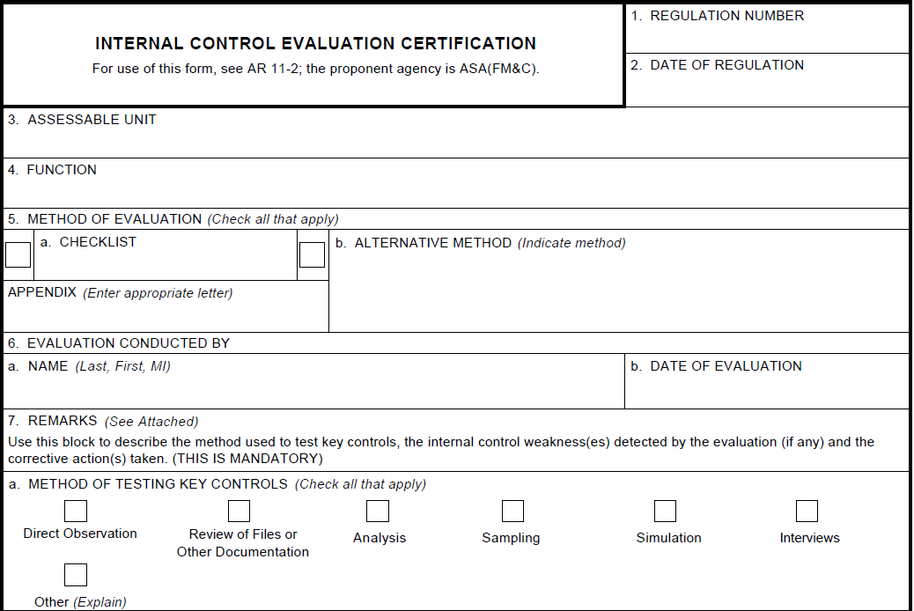
Module 2 Review
Best Control Exercise
DA Form 11-2

Slide 58
Five Standards of Internal Controls
Information & Communication
Control Environment
Risk Assessment
Control Activities
Monitoring

Slide 59
Module 3 - Objectives
Construct a corrective action plan for a material weakness.
Given a material weakness, develop a monitoring plan to review internal controls over time.
Formulate an Corrective Action & Monitoring Plan to monitor material risks.

Slide 60
Material Weakness
What is a material weakness?
The absence or ineffectiveness of internal controls that constitutes a deficiency/weakness that must be corrected.

Slide 61
Material Weakness
Criteria:
It must involve a weakness in internal controls (i.e., not in place, not being used or adequate)
It must warrant the attention of the next level of command (i.e., the higher level must resolve the problem or be aware of it)
Other factors (must be significant and systemic with one or more risk factors):
Actual or potential loss of resources
Sensitivity of resources involved
Magnitude of funds/property/resources.
Unreliable info that could cause bad decisions
Diminished credibility of Army and/or IMCOM
Impaired mission, injury, death

Slide 62
Corrective Action Plan – Breakout Exercise Instructions
Your group has been assigned one (1) deficiency: Missing money, Inventory, Unsecured building, Employee Absences, or Outdated SOPs.
Develop a Corrective Action Plan (CAP) to correct the material weakness/deficiency.
Remember the CAP must include defined achievable milestones that will ultimately result in validated correction of the weakness.
Prove your control will work (what does success look like?)
Complete Sections 1 through 7 of the CAP worksheet on pg 21 of the Participant Guide
You have 10 minutes to complete the exercise.

Slide 63
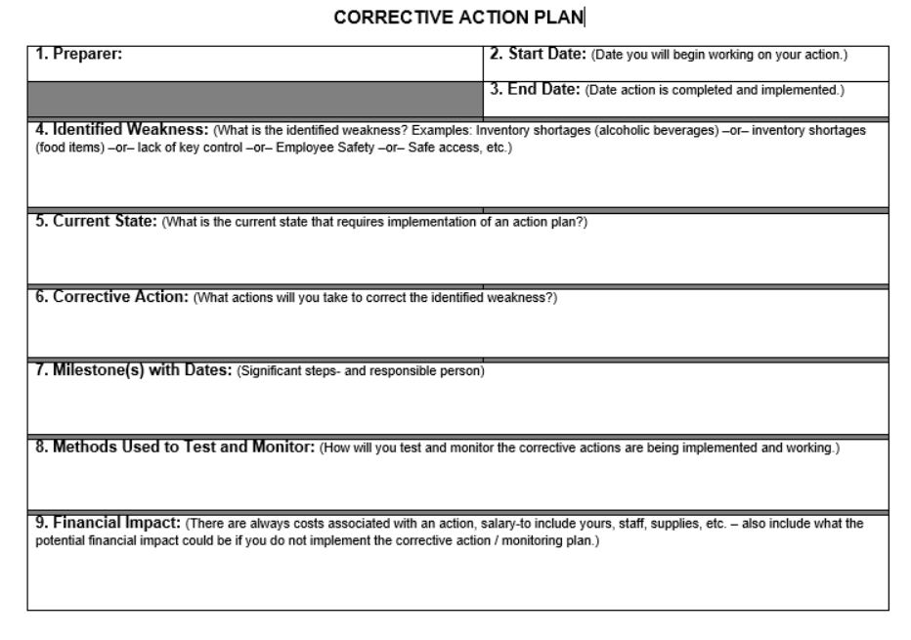
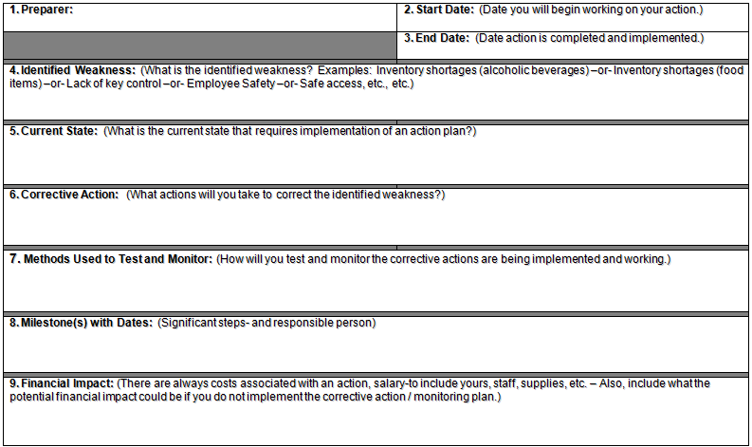
Corrective Action Plan

Slide 64
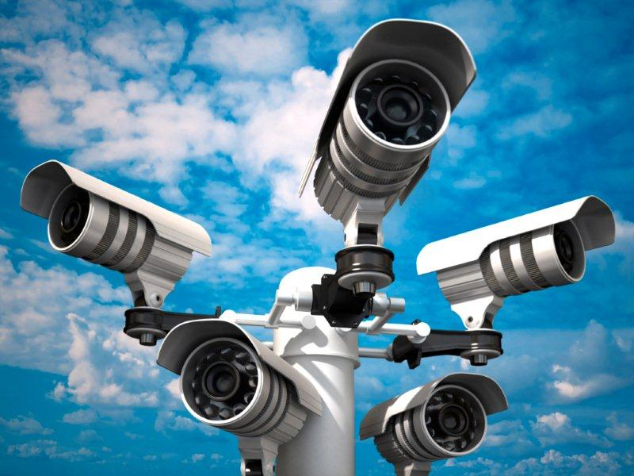
Monitoring
What is monitoring?
Observing and checking the progress or quality of (something) over a period of time; keep under systematic review.

Slide 65
Monitoring Plan – Breakout Exercise Instructions
Based on your group’s identified deficiency and corrective actions, develop a Monitoring Plan.
The Monitoring Plan should include:
What is being monitored.
How it will be monitored.
When it will be monitored.
Who will be responsible for monitoring.
Complete Section 8 of the CAP worksheet.
You have 10 minutes to complete the exercise.

Slide 66
Corrective Action Plan- Financial Impact
What are some financial impacts of having controls in place?
Is there a cost savings?
Is it negative or positive? Why?
Provide a dollar amount for one month of implementing your process/plan/monitoring: $_______
Complete Section 9 of your CAP worksheet with your group.
Select a spokesperson to out-brief your entire plan to the large group.

Slide 67
Module 3 – Objectives
Construct a corrective action plan for a material weakness.
Given a material weakness, develop a monitoring plan to review internal controls over time.
Formulate an Corrective Action & Monitoring Plan to monitor material risks.

Slide 68
NAF Internal Controls
School for Family and MWR
Module 4
Corrective
Action Plans

Slide 69
Module 4 - Agenda
Corrective Action & Monitoring Plan
Course in Review
Administrative Items

Slide 70
Five Standards of Internal Controls
Information & Communication
Control Environment
Risk Assessment
Control Activities
Monitoring

Slide 71
Individual Assignment: Corrective Action Plan Exercise
Identify one (1) deficiency.
Choose one from your own program.
Develop a Corrective Action Plan (CAP) to correct the material weakness/deficiency.
Complete all sections (1-9)
Complete the form individually
Brief your CAP to your group.
Provide feedback to each individual
Update form accordingly
Each table will choose 1 person to brief their CAP to the large group for SME Feedback
Turn in your completed/updated form to the instructors.

Slide 73
Course in Review
Session 1
Session 2
Session 3
Session 4
Identify Breakdowns
Relate Standards to Operational Environment
Determine Level of Risk
Roles & Responsibilities
Identify, Categorize Operational Elements
Identify Drivers
Select Best Control
Evaluate Controls
Corrective Action Plan
Monitoring Plan
Corrective Action Plan Feedback

Slide 74
Course
Expectations

Slide 75
Admin
End of Course Evaluation
Will be in your email when you get back to the office
Required for Graduation
Due no later than 48 hours post Session 4
Approximately 20 minutes to complete
Provide a thoughtful critique of course to include any recommended inclusions/deletions of content or delivery
ACE and IACET CEU Recommendations
ACE: One (1) semester hour in Finance &/or Auditing in the upper division baccalaureate degree category
IACET CEUs: 1.3 in Finance &/or Auditing

Slide 76
THANK YOU!

